Slide 1

A/B Testing for Conversion Rate Analysis
Data Analysis Internship – Project 2
By Kashish Rangwani

Slide 2

Objective
Objective:
To analyze whether a new webpage design (Variant B) performs better than the original version (Variant A) in terms of conversion rate using A/B testing.
Method:
Simulate user behavior
Calculate conversion rates and confidence intervals
Perform hypothesis testing using z-test

Slide 3



Data Simulation
We simulated data using Python for 10,000 visitors on each variant.
Used np.random.binomial() to simulate real-world results.
Variant
Total Visitors
Assumed CR
Simulated Conversions
A
10,000
10%
~1000
B
10,000
12%
~1200

Slide 4
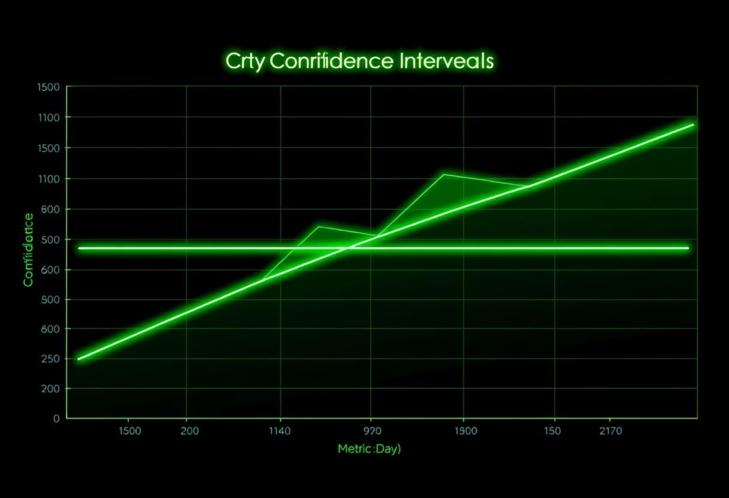
Conversion Rates & Confidence Intervals
Calculated conversion rates and 95% confidence intervals using a custom function.
These ranges help estimate the true success rate for each version.
Variant
Conversion Rate
95% CI (Lower)
95% CI (Upper)
A
~10%
e.g. 9.4%
e.g. 10.6%
B
~12%
e.g. 11.3%
e.g. 12.7%

Slide 5
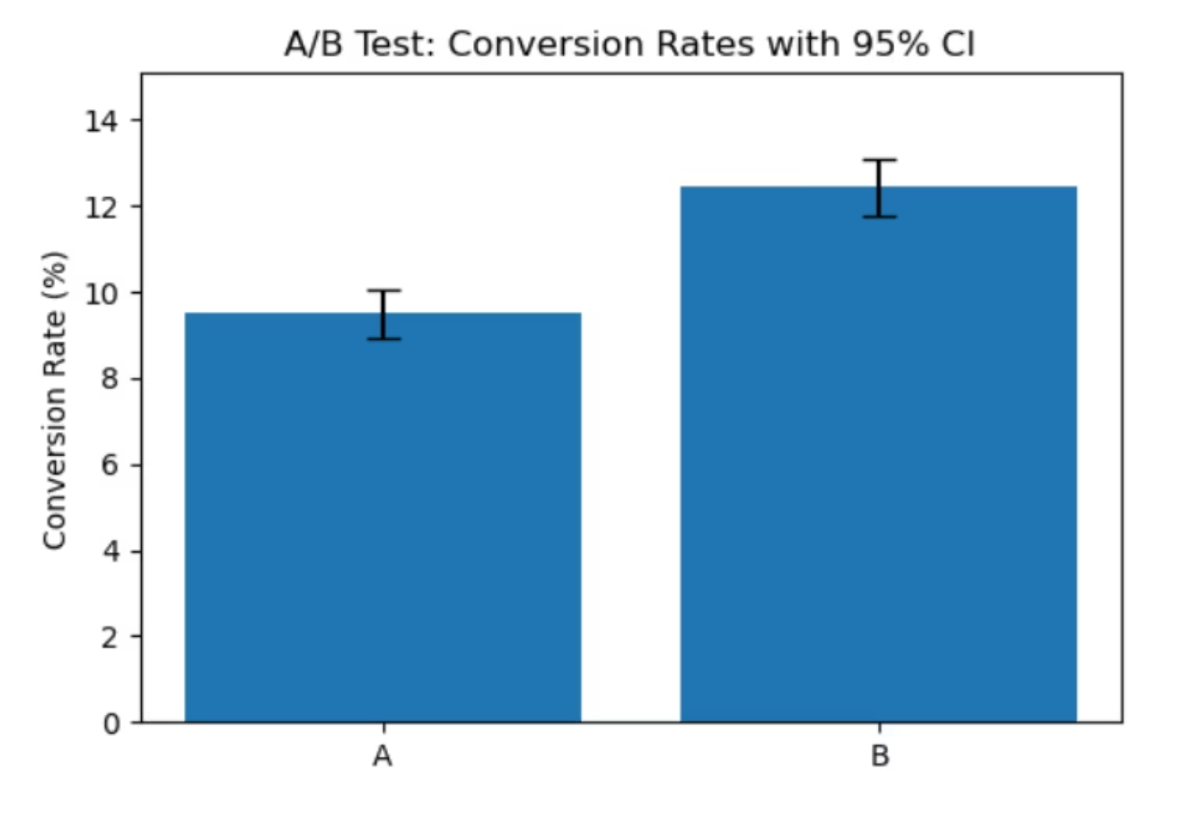
Visualization
Bar chart showing conversion rate comparison with confidence intervals.
Variant A — ~10%
Variant B — ~12%
✅ Visual gap suggests Variant B might be statistically better.

Slide 6

Hypothesis Testing
We used a two-proportion z-test to test the difference in conversion rates.
Hypotheses:
H₀: Variant B is not better than A
H₁: Variant B is better than A
If p-value < 0.05, we reject H₀.
✅ Result: Statistically significant improvement in Variant B

Slide 7

Conclusion & Insights
Variant B outperformed Variant A in conversion rates
Confidence Intervals did not overlap much
z-test confirmed results were not by chance
💡 Insight: A/B testing is a powerful tool to make data-driven product decisions.

Slide 8
Tools & Learnings
🛠 Tools Used:
📚 What I Learned:
Python
Simulating real data
Numpy
Understanding confidence intervals
Pandas
Running statistical tests to validate decisions
Matplotlib
Visualizing and interpreting business data
Statsmodels
Scipy

